Slide 1
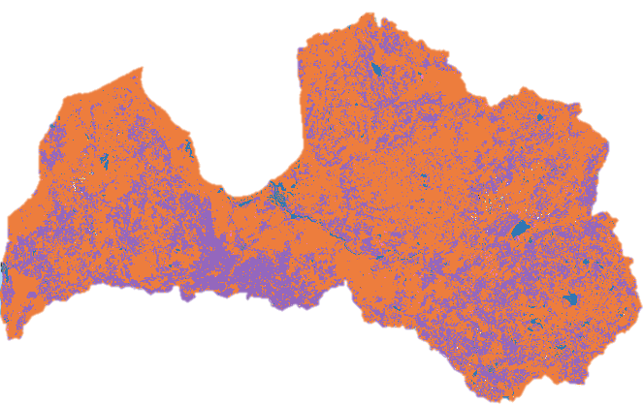

The Visibility of Soviet Union Collapse and European Union Accession on Agricultural Land Use in Latvia
Izzy Rich
Supervisor: Isla Myers-Smith

Slide 2






Icons: Noun Project;
Foley et al., 2005; Daskalova et al., 2018
Notes:
Land conversion (urbanization + agricultural expansion) → potential negative effects on ecosystems

Slide 3



Socio-politico-economic (SPE) context influences agricultural land use patterns
Increase in intensive agriculture
Increase in abandoned agricultural land
1991
Soviet Union Collapse
2004
European Union Accession
Icons: Noun Project;
Reid et al., 2000; Prishchepov et al., 2013

Slide 4
Soviet collective farm
© (2019) S.A. & P.J.Vecrumba

Slide 5
Abandoned collective farm

Slide 6
European Union intensive farm
© 2019 Pixabay

Slide 7
Traditional Latvian farm

Slide 8
Filling the knowledge gap
Both events studied separately on regional scales
Unclear if broad-scale signature left on Latvian landscape
My study aims to provide an agricultural land use classification between 1989-2011 to determine broad-scale change patterns influenced by Soviet Union Collapse and European Union accession, with the ultimate potential of providing evidence for country-wide policies aiming to dampen negative land use change impacts.
Prishchepov et al., 2012; Vanwambeke et al., 2012; Fonji & Taff, 2014

Slide 9
Research questions
1. Across Latvia, is intensive, extensive and abandoned agricultural land use change visible within the three years following socio-politico-economic events?
2. Is there a time lag (six years) between socio-politico-economic events and the visibility of LUC?
Photo: Agnis Rainbahs
Notes:
Talk about transition and say why you haven’t included it here
Define event
Talk through hypotheses

Slide 10
Classifications
Trained classifier
Training sample
Decision tree
Voting
Classify all study data
Decision tree
Training sample
Decision tree
Training sample
TRAIN (80%)
Testing sample
Trained classifier
Test error & accuracy
TEST (20%)
Made in Microsoft PowerPoint
Notes:
Explain why made own classification
Explain supervised random forest classifcation
Explain 80/20 split

Slide 11



Datasets
Satellite imagery (Landsat-5)
Field data
(LUCAS)
Cloud-corrected
Summer months selected
Visible and infrared bands selected
Filtered to include intensive and extensive agriculture, abandoned agricultural land (key classes); forested and artificial land, wetlands and water (additional classes)
Points to polygons (90-metre buffer)
Icons: Noun Project

Slide 12

Classification
Trained classifier
Trained on bandwidths of training points
30 decision trees
Assessed error and accuracy
Test data
Pixels screenshotted in Google Earth Engine. 500 kilometre scale

Slide 13
Screenshotted in Google Earth Engine; edited in Microsoft PowerPoint. 500 kilometre scale
Notes:
Data collected for each cell
Pixel cover converted to area (km²)

Slide 14
Statistical analyses
mod1 ← lmer(area ~ year_group + (1|grid))*
Fixed effect: Year group (before and after each event)
Response: Average area (km²) of each land use type per cell
Random effect: Grid (ID) to account for spatial autocorrelation
*Completed for three years (directly after) and six years (lag) each event
mod2 ← lm(year_area ~ year)**
Predictor: Year (1989-2011)
Response: Area (km²) of each land use type
**segmented analysis

Slide 15
Intensive agriculture (purple) observed at country level
Example classification image from Google Earth Engine (2011). Orange: forest, blue: water and purple: intensive agriculture. Extensive agriculture (green) and abandoned agricultural land (brown) not observed at this scale (50 km).

Slide 16
Soviet Union Collapse: Immediate impacts
Significant decrease in abandoned land
No clear change in intensive and extensive land
Dashed line: effect size; error bar: error around effect size; Solid line: actual data (N = 255).

Slide 17
Soviet Union Collapse: Impacts six-years following
Significant decrease in abandoned land
No clear change in extensive land
Significant decrease in intensive agriculture
Photo: Agnis Rainbahs

Slide 18
European Union Accession: Immediate impacts
Significant decrease in abandoned land
No clear change in extensive land
Significant increase in intensive agriculture
Dashed line: effect size; error bar: error around effect size; Solid line: actual data (abandoned N = 255; intensive N = 258). Scale of y-axis different for effective visualisation.

Slide 19
European Union Accession: Impacts six-years following
No clear change in abandoned land
No clear change in extensive agriculture
Significant increase in intensive agriculture
Photo: Agnis Rainbahs

Slide 20
Land use trajectories
Intensive Abandoned Extensive
N.B: Scale differs for each land use type

Slide 21
Key findings
Intensive land use trajectory aligns with events
Abandoned land cover change does not closely follow either event
Scale of extensive land use cover change not significant
Photo: Agnis Rainbahs

Slide 22
Limitations and further work
Examination of other factors and events
Limited training points
Limited classification accuracy
Photo: Agnis Rainbahs;
Foody, 2002; Lu et al., 2004; Vanwambeke et al., 2012

Slide 23

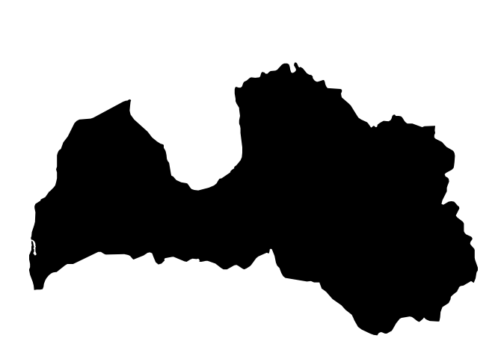

Implications & conclusions
Satellite imagery can link land use change to events on a country scale
Country level land use patterns can be observed across Latvia
Classification accuracy & precision is vital when determining clear patterns
Icons: Noun Project

Slide 24
Questions?

Slide 25
References

